Slide 1
NCI update: ICB-induced T cell proliferation & irAE development
3 14 2024
Ty Bottorff – Bioinformatics postdoc
Linsley lab

Slide 2
Outline
Prior evidence for T cell proliferation after ICB being associated with irAEs
Goal
Methods
Results
Next steps

Slide 3
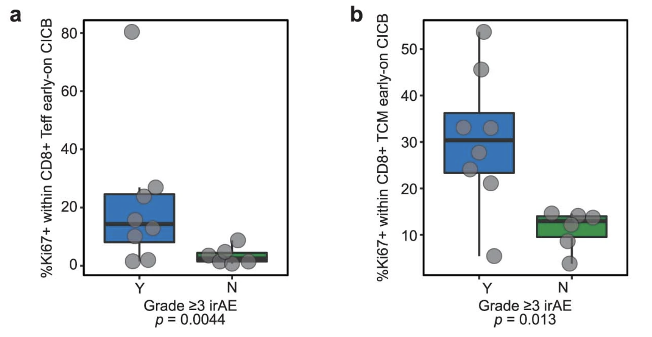
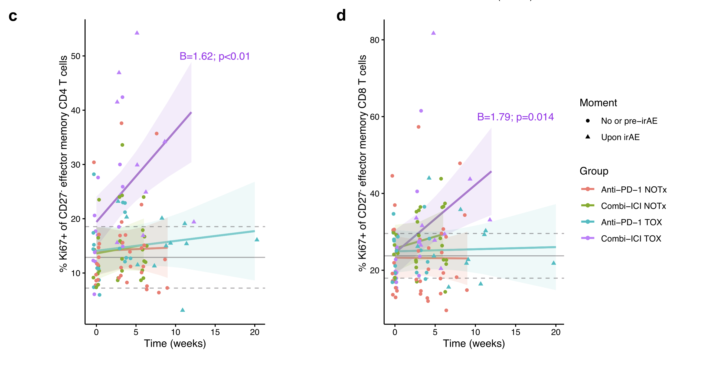
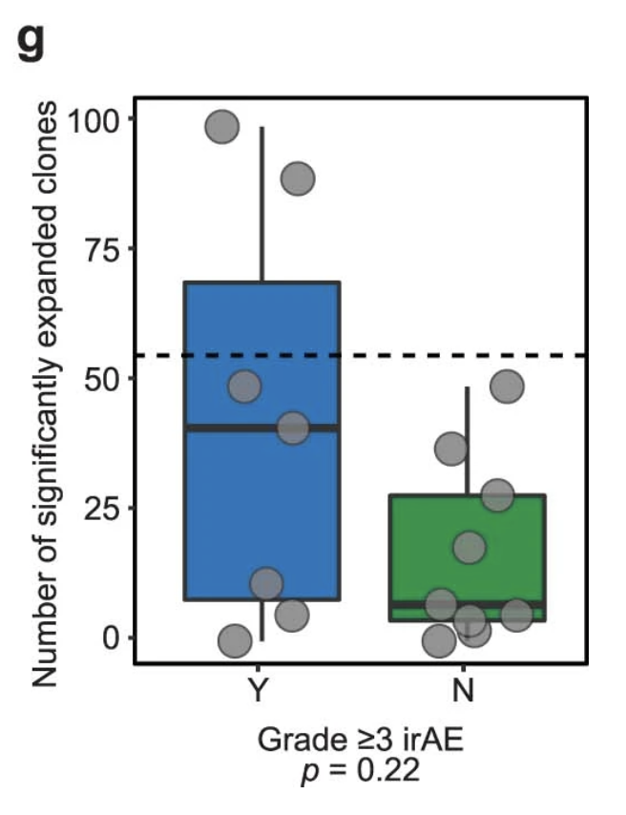
irAEs associated with T cell proliferation following ICB (PMID27698113, PMID35762356, PMID36693381, PMID36173679)
NOTx: no irAE
TOX: irAE
Andrews et al. (2021), Nat Med
van Eijs et al. (2023), Cancer Immunol Immunother
Notes:
Andrews: profiled the blood, tumor and gut microbiome of 77 patients with advanced melanoma treated with CICB, with a high rate of any ≥grade 3 immune-related adverse events (49%) with parallel studies in pre-clinical models. Tumor-associated immune and genomic biomarkers of response to CICB were similar to those identified for ICB monotherapy, and toxicity from CICB was associated with a more diverse peripheral T-cell repertoire. Profiling of gut microbiota demonstrated a significantly higher abundance of Bacteroides intestinalis in patients with toxicity, with upregulation of mucosal IL-1β in patient samples of colitis and in pre-clinical models
van Eijs: 44 ICI-treated patients (24 anti-PD-1 monotherapy, 20 combined anti-PD-1/anti-CTLA-4; cICI), of whom 21 developed irAEs, and 10 healthy donors. IrAEs after cICI were characterized by significantly enhanced proliferation of Th1-associated, mainly (CD4⁺) CD27⁻ effector memory T cells, as well as Th17-associated immune responses and germinal center activation (reflected by CXCL13 and IL-21 increases). Particularly double-positive PD-1⁺LAG-3⁺ CD8⁺ T cells showed enhanced cytotoxic capacity in patients with irAEs after cICI. Within anti-PD-1 monotherapy, irAEs were associated with modestly enhanced Th1-associated responses reflected by increased serum CXCL9 and CXCL10.
CD27- referring to TEM I think
PMID28031229 shows opposite (increased rather than decreased TCR diversity associated with irAEs)

Slide 4
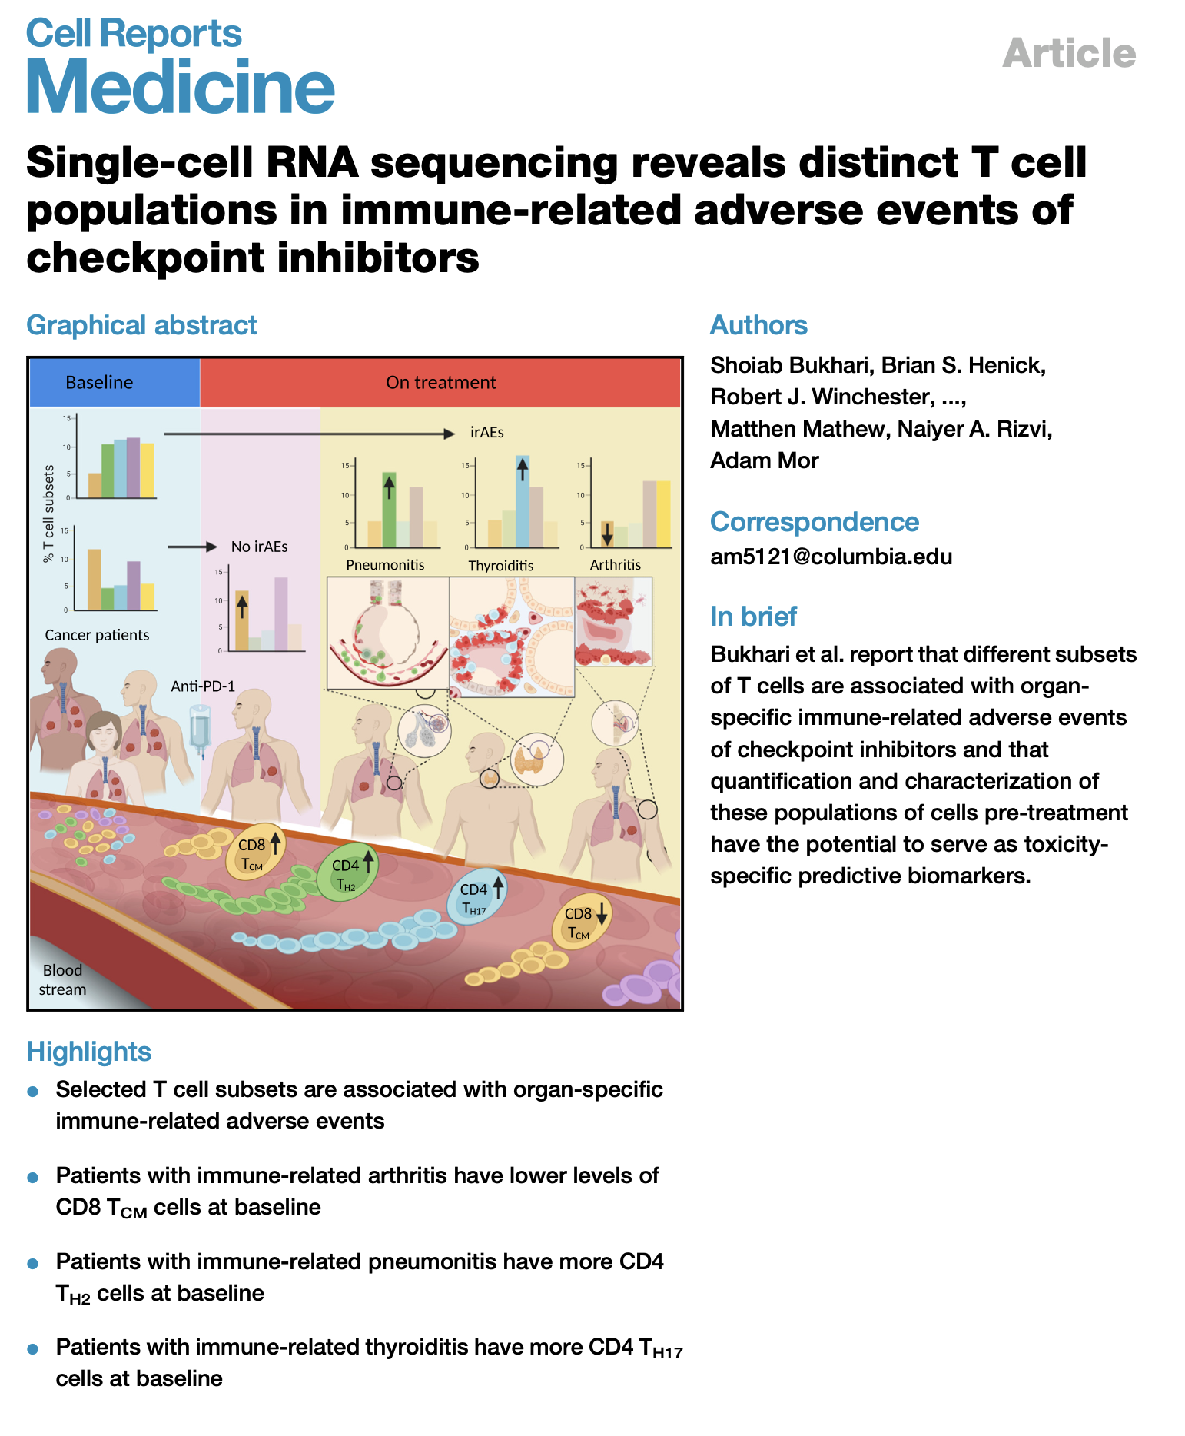
Different organ irAEs may have different driving cell types (PMID38357008)
Notes:
lower baseline levels of CD8 TCM cells in arthritis irAE patients, higher CD4 Th2 baseline levels in pneumonitis irAE patients, higher CD4 Th17 baseline levels in thyroiditis irAE patients (PMID: 36513074)

Slide 5
Goal
Investigate relationship between T cell subtype abundances and irAE development across multiple (colitis) datasets

Slide 6
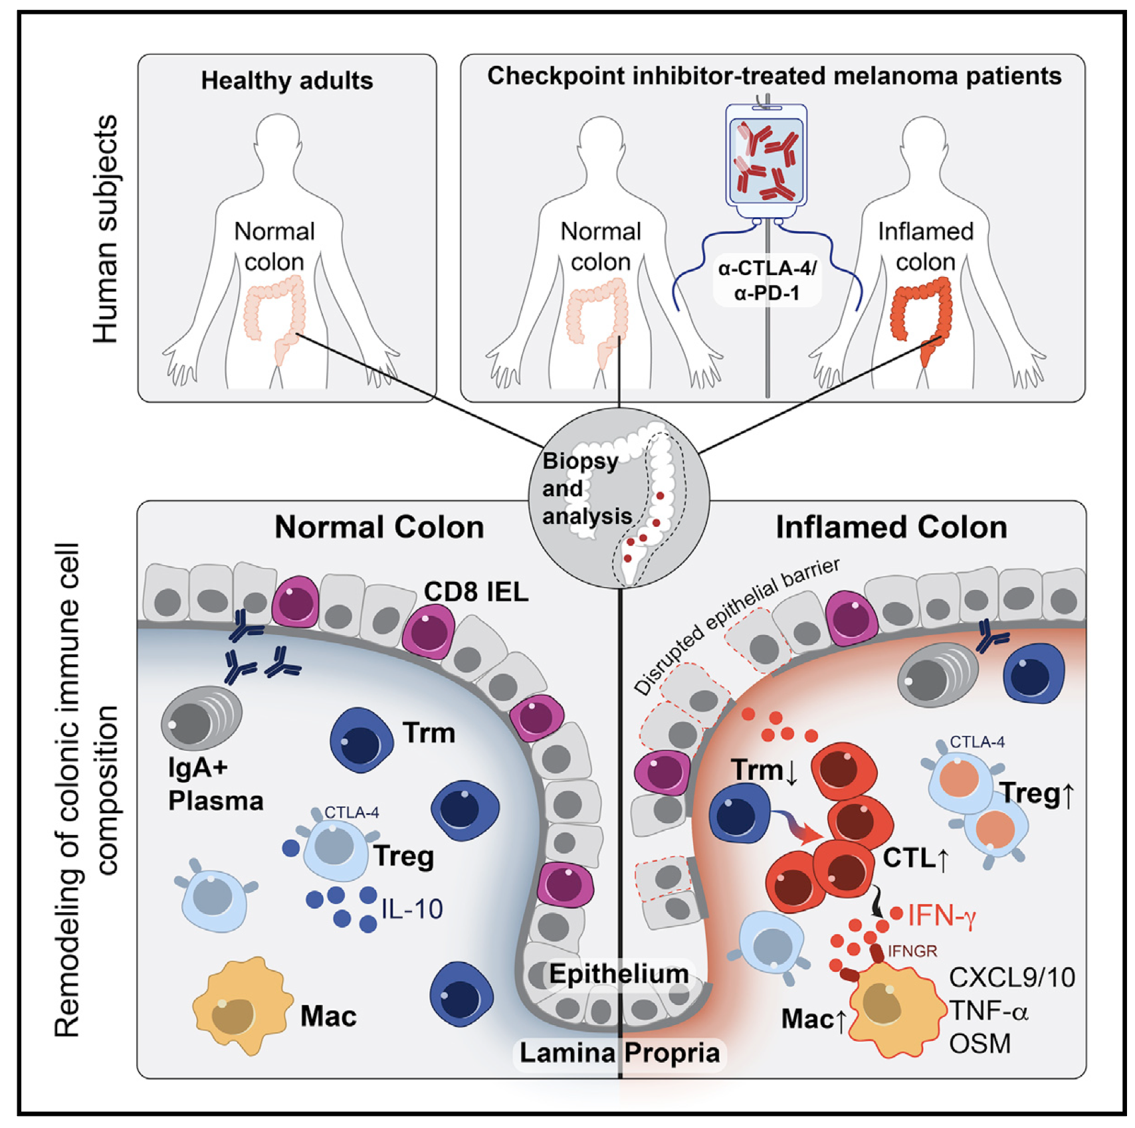
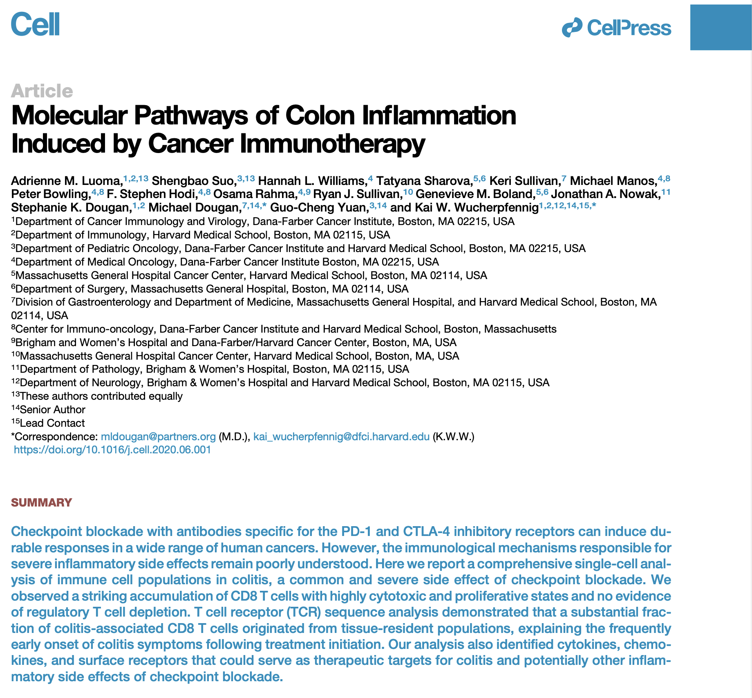
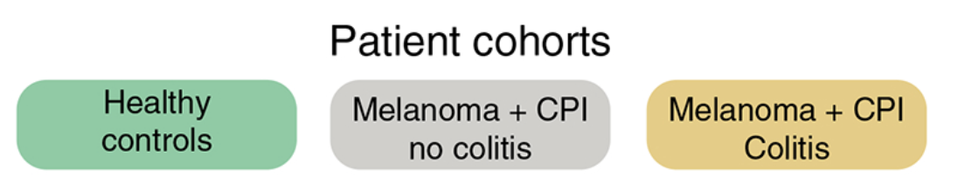
n = 8 n = 6 n = 8
Colon tissue from melanoma patients treated with CTLA-4 blockade (or combo)
Notes:
Colitis seq details:
Sequencing of scRNA-seq libraries
CD3⁺ T cell gene expression libraries were sequenced on the Illumina HiSeq 4000 platform with 150 bp paired-end read configuration. CD45+ MNC libraries were sequenced either on the Illumina HiSeq 4000 platform with 150 bp paired-end read configuration or the HisSeq 2500 platform on rapid run mode. We obtained >30,000 reads per cell for all samples, which was particularly important with CD45+ libraries for sufficient sampling of non-immunoglobulin genes given the high plasma B cell count. TCR V(D)J libraries were sequenced on the Illumina MiSeq (V2 flowcell), HiSeq 2500, or HiSeq 4000 platform, all on 150 bp paired-end read configuration.
Cell mapping:
We used two complementary approaches to annotate the identities of different cell clusters: (1) we checked whether the well-studied marker genes of different immune cell types were in the top rank of differential expressed genes of query cluster and then assigned the most likely identity for each cell cluster; (2) applied an unbiased cell type recognition method named SingleR (v0.99.10, R package) (Aran et al., 2019), which leverages reference transcriptomic datasets of known cell types for annotation (Martin et al., 2019; Smillie et al., 2019). We first applied SingleR to determine if the predicted annotations for a query cluster based on different reference datasets were consistent, and then assigned this cluster as the predicted cell type annotation; alternatively, we checked which genes were in the top rank of differentially expressed gene list of this cluster
More CTLA-4 blockade it seems
Time on ICI:
most ~1-2 treatment cycles
~1 month from treatment start before symptoms
~2 weeks from treatment end before symptoms
~ few days after symptoms before endoscopy

Slide 7
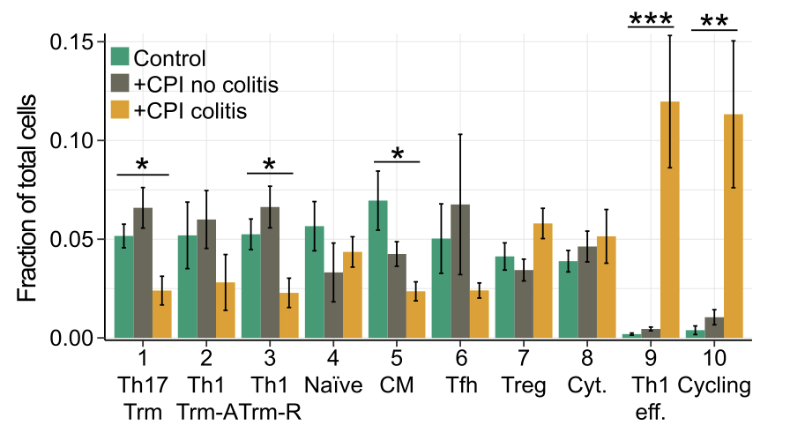
Main CD4 abundance conclusions: cycling, effector CD4s up in colitis tissue, Trms down
Luoma et al. (2020), Cell

Slide 8
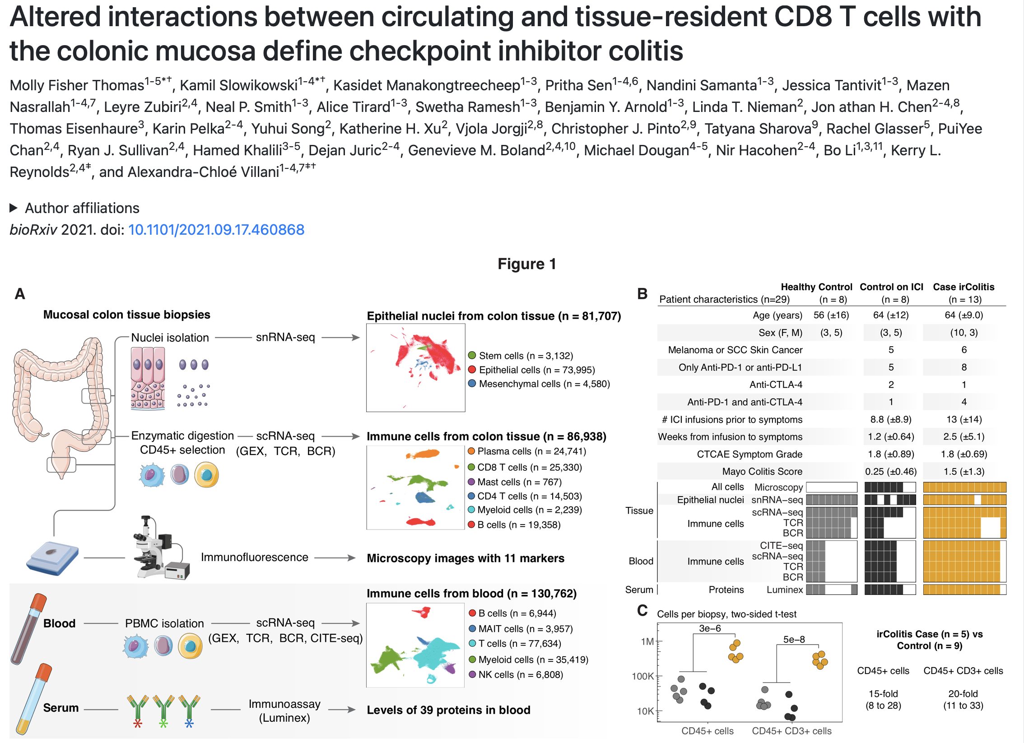
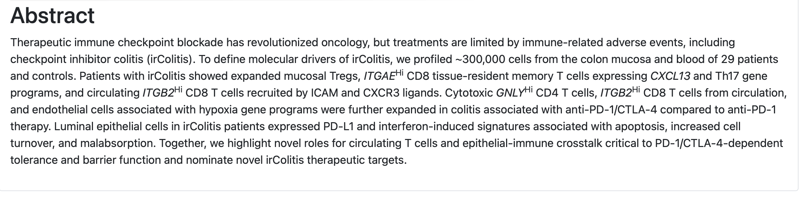
Colon tissue from melanoma/lung cancer patients treated with PD-1 blockade (or combo)
Notes:
biopsies for this study were taken from the descending colon, sigmoid, and rectum and analyzed together
most patients on ICI therapy had melanoma or lung cancer, were treated with PD-1 blockade (either as monotherapy or in combination with anti- CTLA-4), and were biopsied within two weeks of symptom onset
of the 8 control patients on ICI therapy, 4 had ICI-related gastritis and/or enteritis with sparing of the colon
used canonical genes to group immune cells into broad cell types including B cells (MS4A1, JCHAIN), T cells (CD3D, CD8A, CD4), and myeloid cells (LYZ)
HC and ICI no colitis aggregated together for all remaining analyses (didn’t see big differences between them)

Slide 9
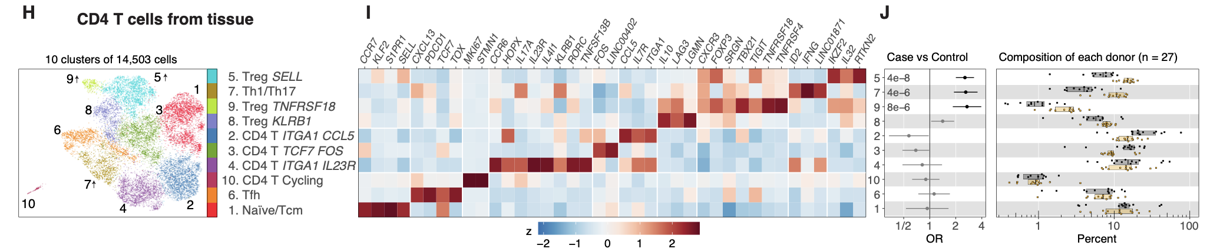
Main CD4 abundance conclusion: Tregs up in colitis tissue
Thomas (2021), bioRxiv
Notes:
HC and ICI no colitis aggregated together for all remaining analyses (didn’t see big differences between them)
Tregs up

Slide 10
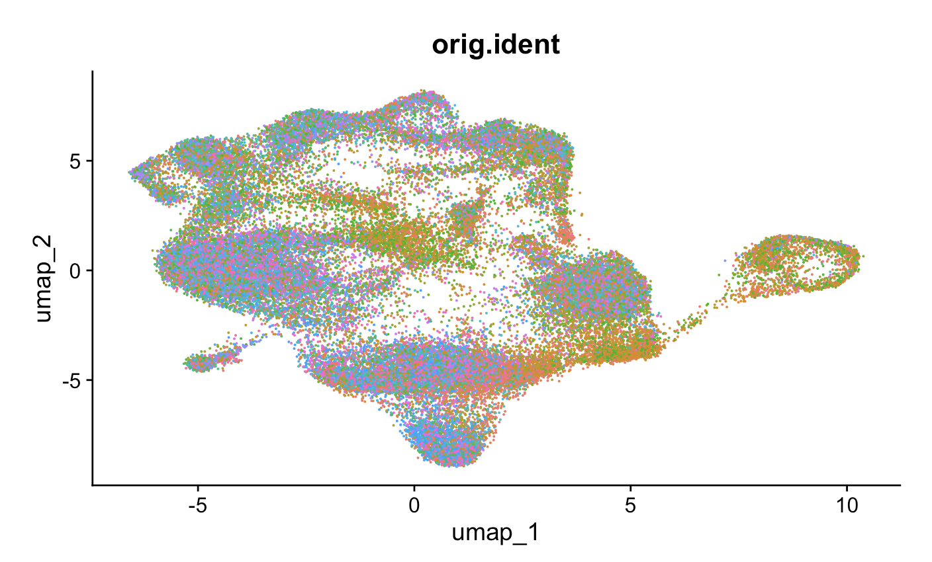
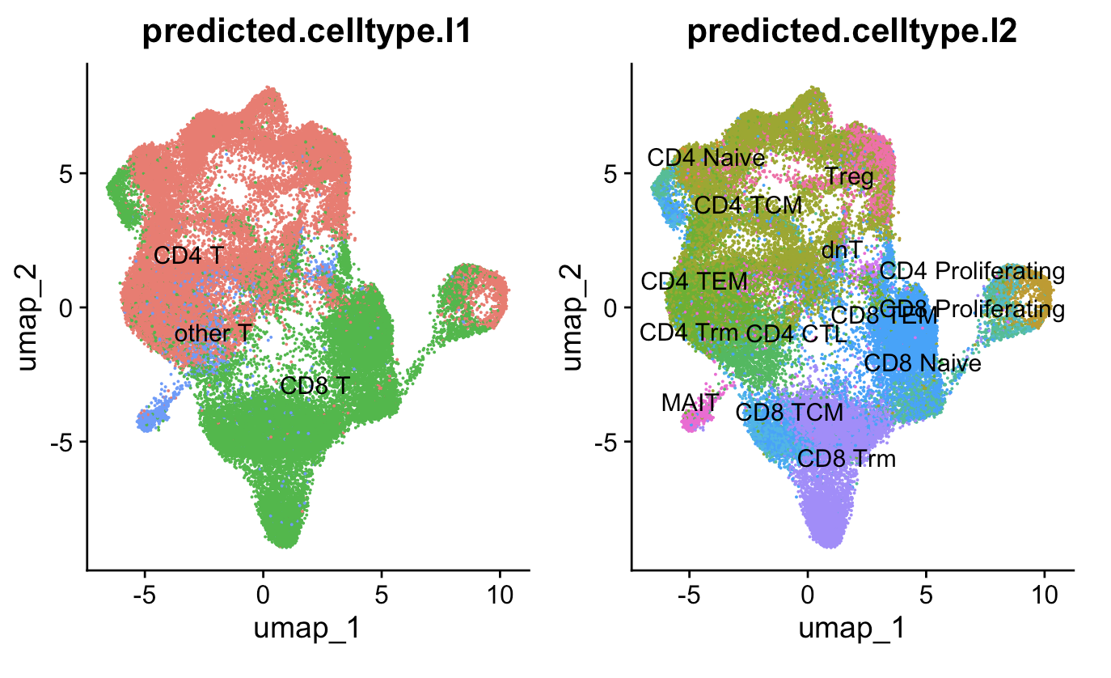
Methods
Patient ID
Quality control
Data normalization
Highly variable feature selection
Data scaling
Dimensional reduction
Clustering of cells
Reference map clusters to identify cell (sub)types
Remove non-T cells, repeat steps 5-7
CD69, CD49a, CD101, CD103 markers used for Trms
Luoma et al. (2020), Cell
Notes:
Luoma: ~129k cells remain after QC (~13k cells dropped), ~50k T cells
Luoma: "nFeature_RNA_min" = 200,
"percent_mito" = 11
Normalize:
that normalizes the feature expression measurements for each cell by the total expression, multiplies this by a scale factor (10,000 by default), and log-transforms the result
Scaling:
Shifts the expression of each gene, so that the mean expression across cells is 0
Scales the expression of each gene, so that the variance across cells is 1
This step gives equal weight in downstream analyses, so that highly-expressed genes do not dominate
Why I used different cell typing methods
didn’t want to use manual markers (as both papers at least partially did), even though I ended up doing this to get Trms
Mostly agree anyways so it’s not that big of a deal
Worth following up with new cell typing methods perhaps as a next step
4) Cell type abundance differences robust i.e. seen via both methods more interesting to follow up on (i.e. proliferating CD4 Ts)
Ref mapping:
We then find anchors between reference and query.
We then transfer cell type labels and protein data from the reference to the query. Additionally, we project the query data onto the UMAP structure of the reference.

Slide 11
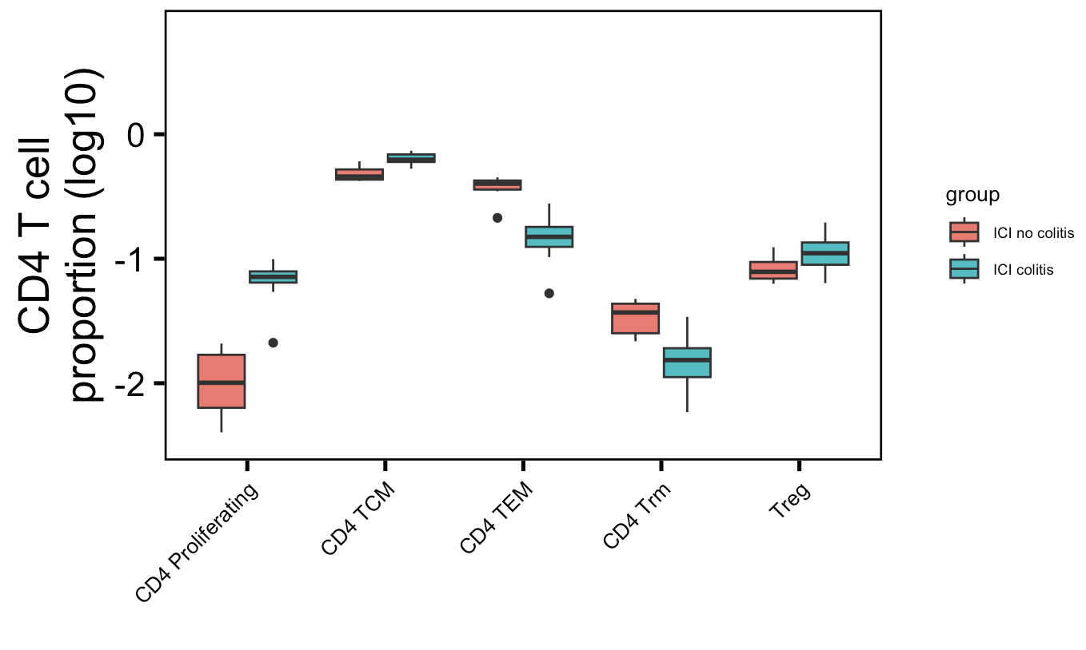
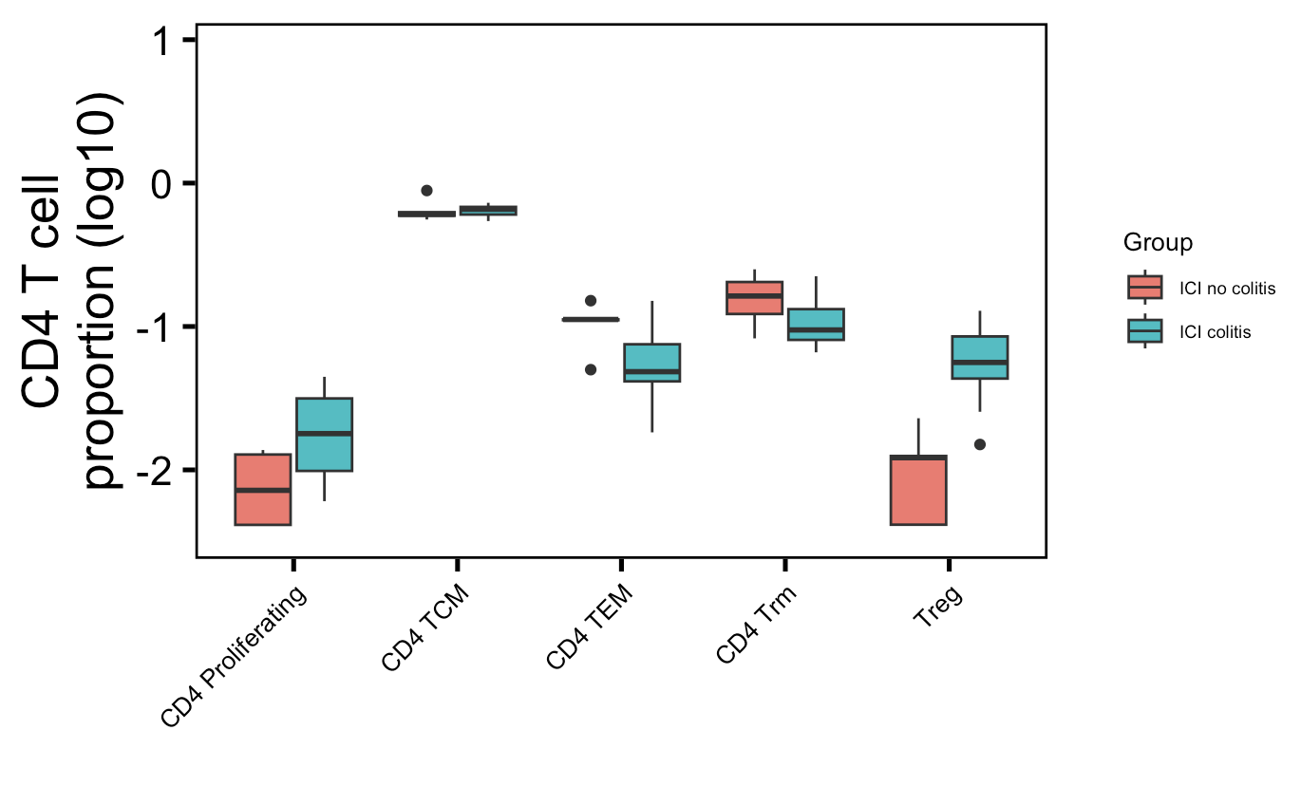
More proliferating CD4s and fewer CD4 TEMs in colitis tissue, ~consistent across two colitis datasets
Luoma (2020), Cell
Thomas (2021), bioRxiv
**
**
**
*
p =
0.07
**
→
→
→
→
: up in their analysis
→
: down in their analysis
Wilcoxon rank sum test. **, padj < 1e-2; *, padj < 0.05
Notes:
Basically not sure how useful this will be for cytometry people as it’s 1) in colon tissue, 2) doesn’t replicate super well with other papers (yes it does with same paper though but…)

Slide 12
Conclusions
More proliferating CD4s and fewer CD4 TEMs in colitis tissue
TCR features are generally very similar between those who develop irAEs and those who don’t (data not shown)
Model
ICB unleashes T cells that were previously inhibited
Unleashed T cells are activated via recognition of tumor neoantigens/TAAs (in responders) and/or autoantigens/commensal microbial antigens (in patients w/ irAEs), clonally expand

Slide 13
Next steps
Apply findings to develop clinical predictors of irAEs
Why do certain patients develop irAEs and others don’t?

Slide 14

Acknowledgements
Peter Linsley
Datasets
Luoma et al. (2020), Cell
Thomas (2021), bioRxiv
Bioinformatics group
Alex Hu
Erin Witkop
Matt Dufort
Matt Lawrence
Hannah DeBerg
Thomas Edwards
Tomasz Janczyk

Slide 15
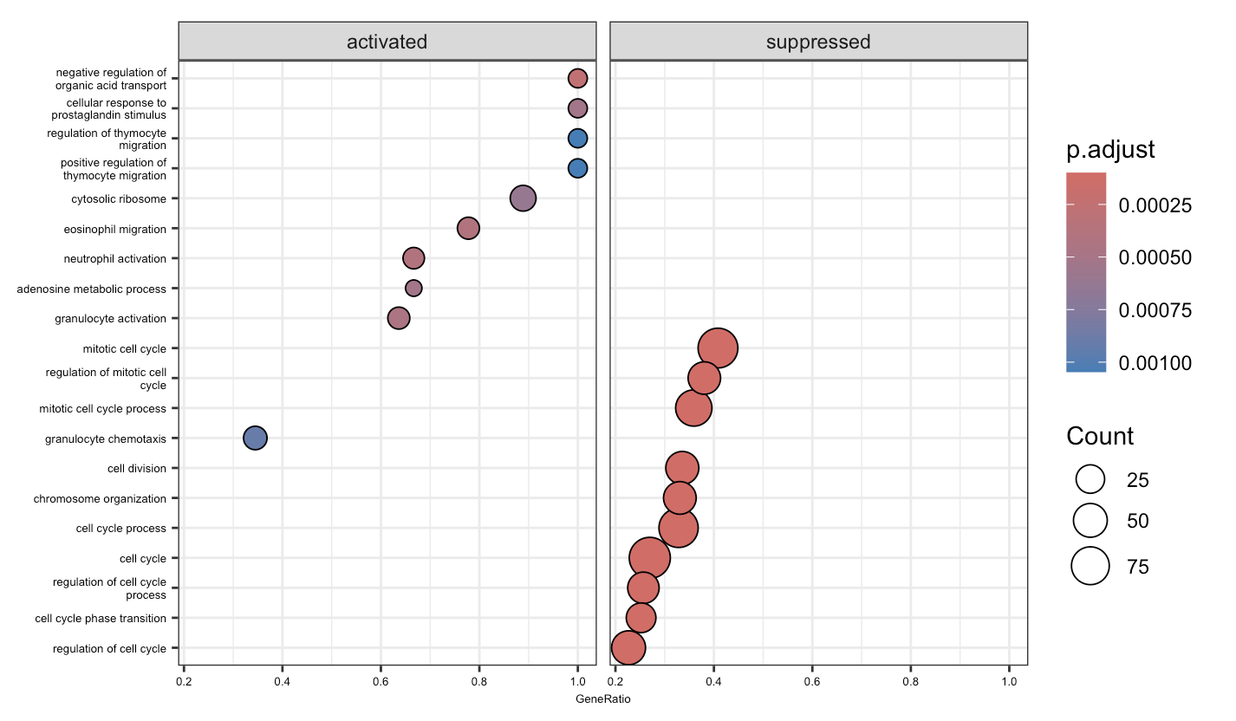
What actually are these CD4 TEMs in Luoma et al. (2020), Cell dataset?
Notes:
GSEA from DEGs from CD4 TEMs vs. other CD4s

Slide 16
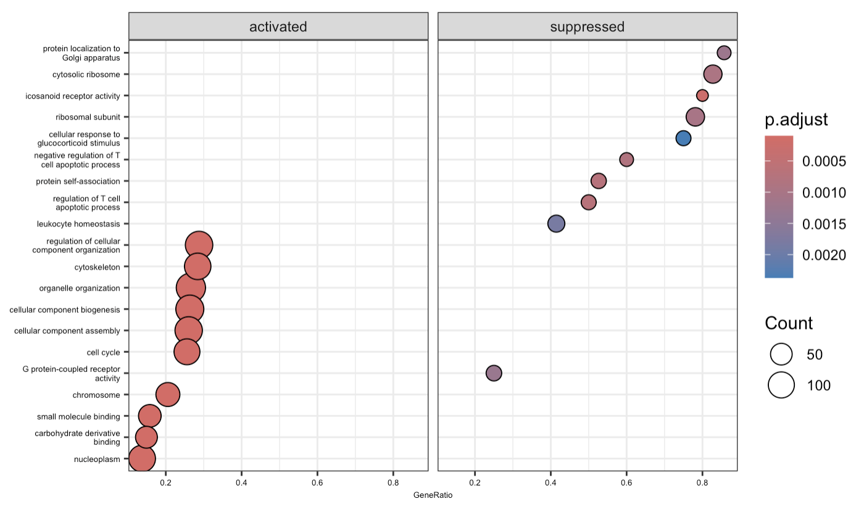
What actually are these CD4 proliferating Ts in Luoma et al. (2020), Cell dataset?
Notes:
GSEA from DEGs from CD4 proliferating vs. other CD4s

Slide 17
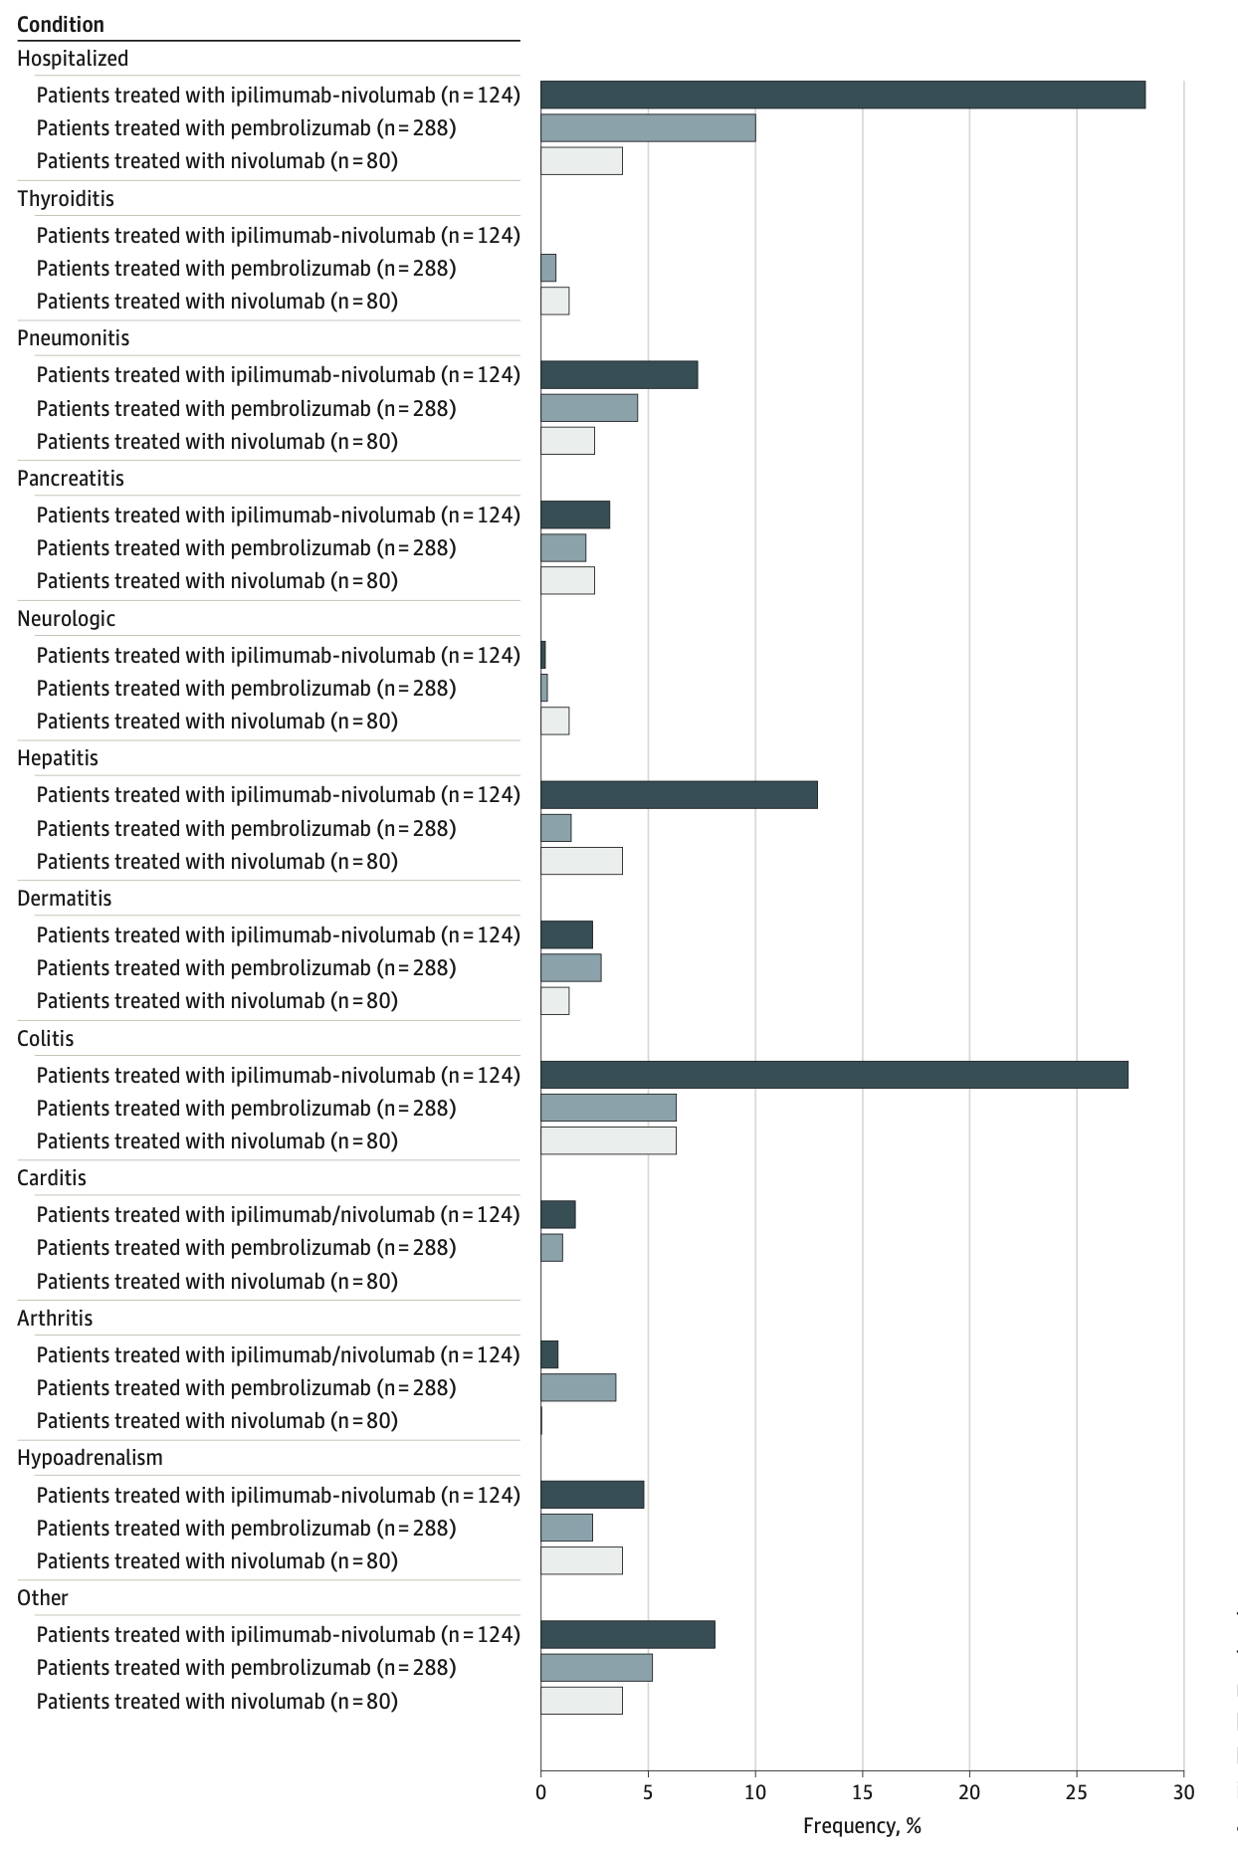
irAEs are rather common and can be severe
Watson et al. JAMA Netw Open. 2022
Notes:
T cell characteristics associated with toxicity to immune checkpoint blockade in patients with melanoma
Autoimmune toxicity occurs in up to 60% of patients treated with immune checkpoint inhibitor (ICI) therapy
Ipilimumab: CTLA-4
Pembrolizumab/nivolumab: PD-1
Perhaps worth trying to make analogy between viral infections preceding autoimmunity and tumor response preceeding irAEs?

Slide 18
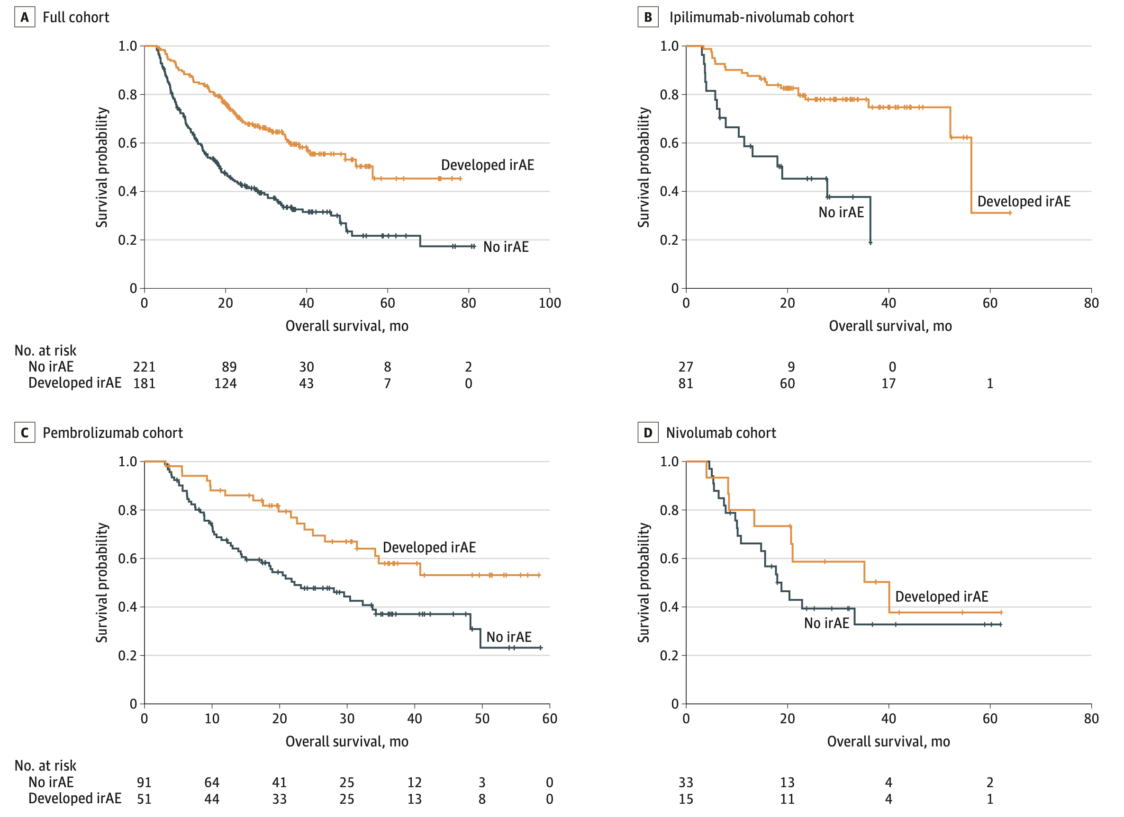
irAE development is associated with anti-tumor response (PMID31021392, PMID26501224, PMID26446948)
Watson et al. JAMA Netw Open. 2022
Notes:
Association of checkpoint inhibitor-induced toxic effects with shared cancer and tissue antigens in non-small cell lung cancer:
irAEs associated with response to therapy (also can cite Association of vitiligo with tumor response in patients with metastatic melanoma treated with pembrolizumab), also Nivolumab in resected and unresectable metastatic melanoma: characteristics of immune-related adverse events and association with outcomes
Characterization of anti-cancer immune response associated with immune-related adverse events in patients with kidney cancer (meeting abstract)
- more irAEs in ICB responders, not a new finding

Slide 19
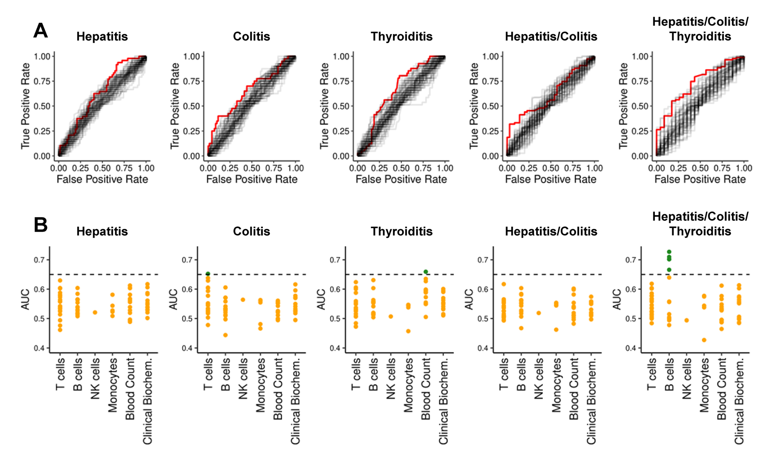
Pre-therapy data generally struggle to reliably predict irAE risk
AUCs for previously reported biomarkers and clinical parameters (68)
Glehr et al. Front Immunol. 2022
Notes:
An AUC of 0.5 suggests no discrimination (equivalent to random guessing), while an AUC of 1 indicates perfect discrimination (for predicting irAE)
heterogeneity amongst irAE organs likely complicates prediction
Germline variants associated with toxicity to immune checkpoint blockade: IL7 cryptic exon, IL7 supports aberrant immune activity in autoimmunity, limits organ toxicity during antiviral immune response, blocks PD-1 leading to T1D (blocking checkpoint when it would have prevented autoimmunity, so IL7 acts as a natural ICB and is therefore rationally associated with irAEs
lower baseline levels of CD8 TCM cells in arthritis irAE patients, higher CD4 Th2 baseline levels in pneumonitis irAE patients, higher CD4 Th17 baseline levels in thyroiditis irAE patients (PMID: 36513074)
low baseline circulating MAITs associated with irAE colitis (PMID: 32734627, ~coincides with my analysis)
activated CD4 TEM abundance (in PBMCs) associated with irAE development (PMID: 35027754, ~disagrees with my analysis)
T cell characteristics associated with toxicity to immune checkpoint blockade in patients with melanoma: BASELINE activated CD4 effector memory T abundance and TCR diversity associated with irAE
# Germline genetic variants are associated with development of insulin-dependent diabetes in cancer patients treated with immune checkpoint inhibitors
- *NLRC5* germline mutation as potential predictive biomarker for T1D irAE

Slide 20
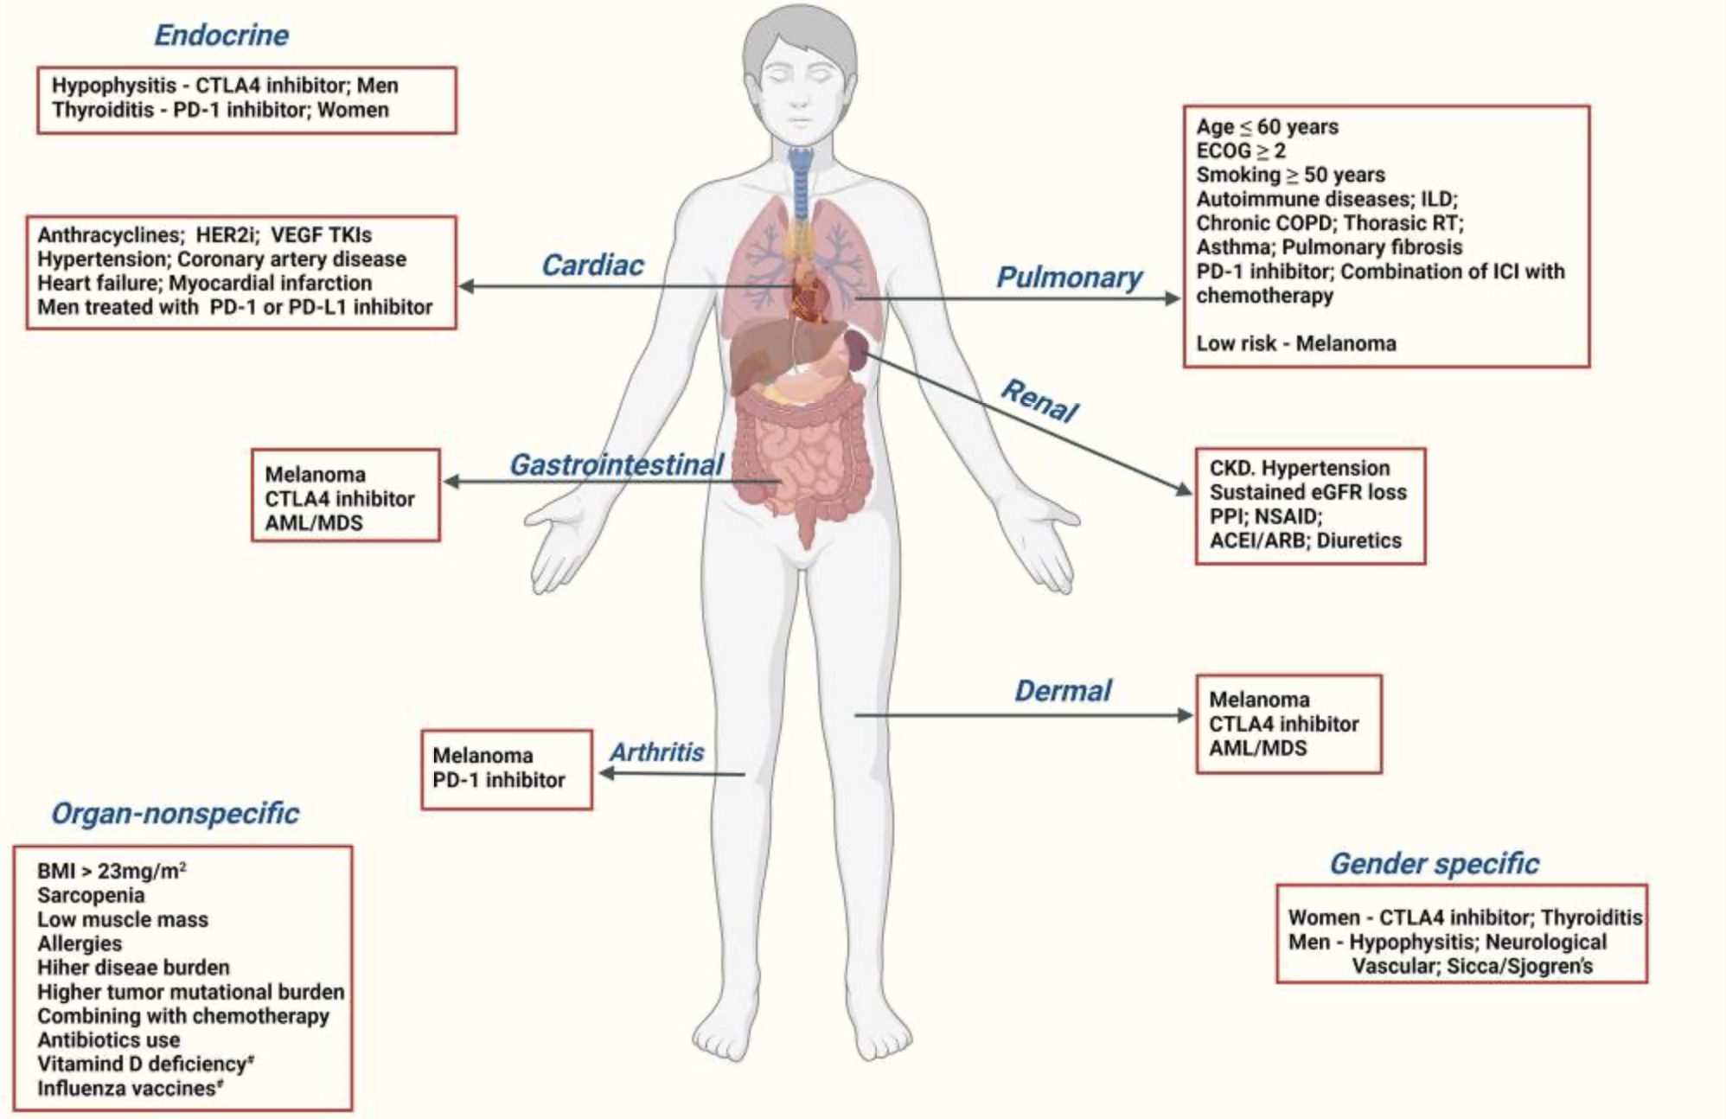
There are many proposed biomarkers for irAE development, but there exists a need for more reliable irAE prediction
Chennamadhavuni et al. Front Immunol. 2022
Notes:
Glehr et al. Front Immunol. 2022
unable to reliably predict risk of irAEs in most cases from pre-therapy flow cytometry and clinical data
Germline variants associated with toxicity to immune checkpoint blockade: IL7 cryptic exon, IL7 supports aberrant immune activity in autoimmunity, limits organ toxicity during antiviral immune response, blocks PD-1 leading to T1D (blocking checkpoint when it would have prevented autoimmunity, so IL7 acts as a natural ICB and is therefore rationally associated with irAEs

Slide 21
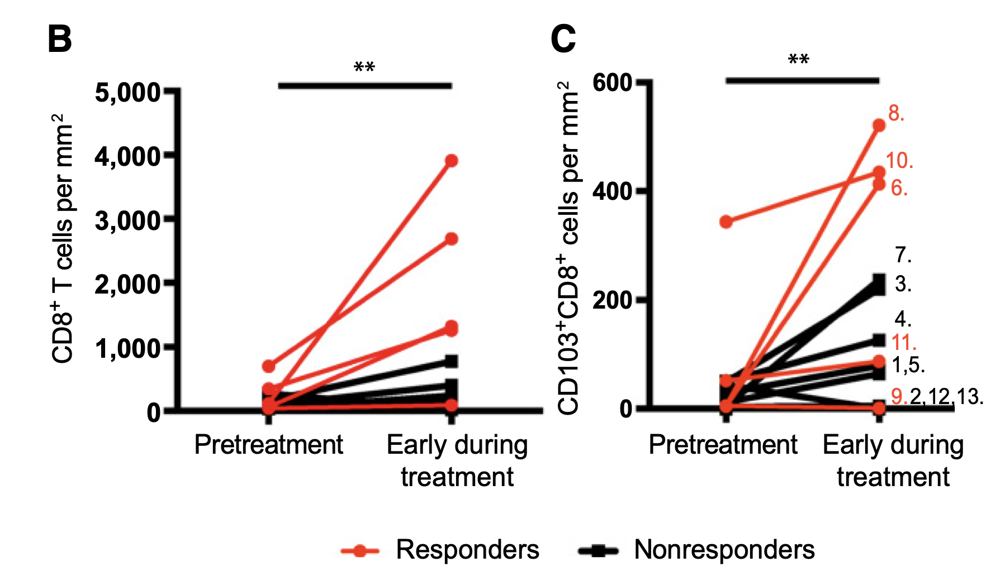
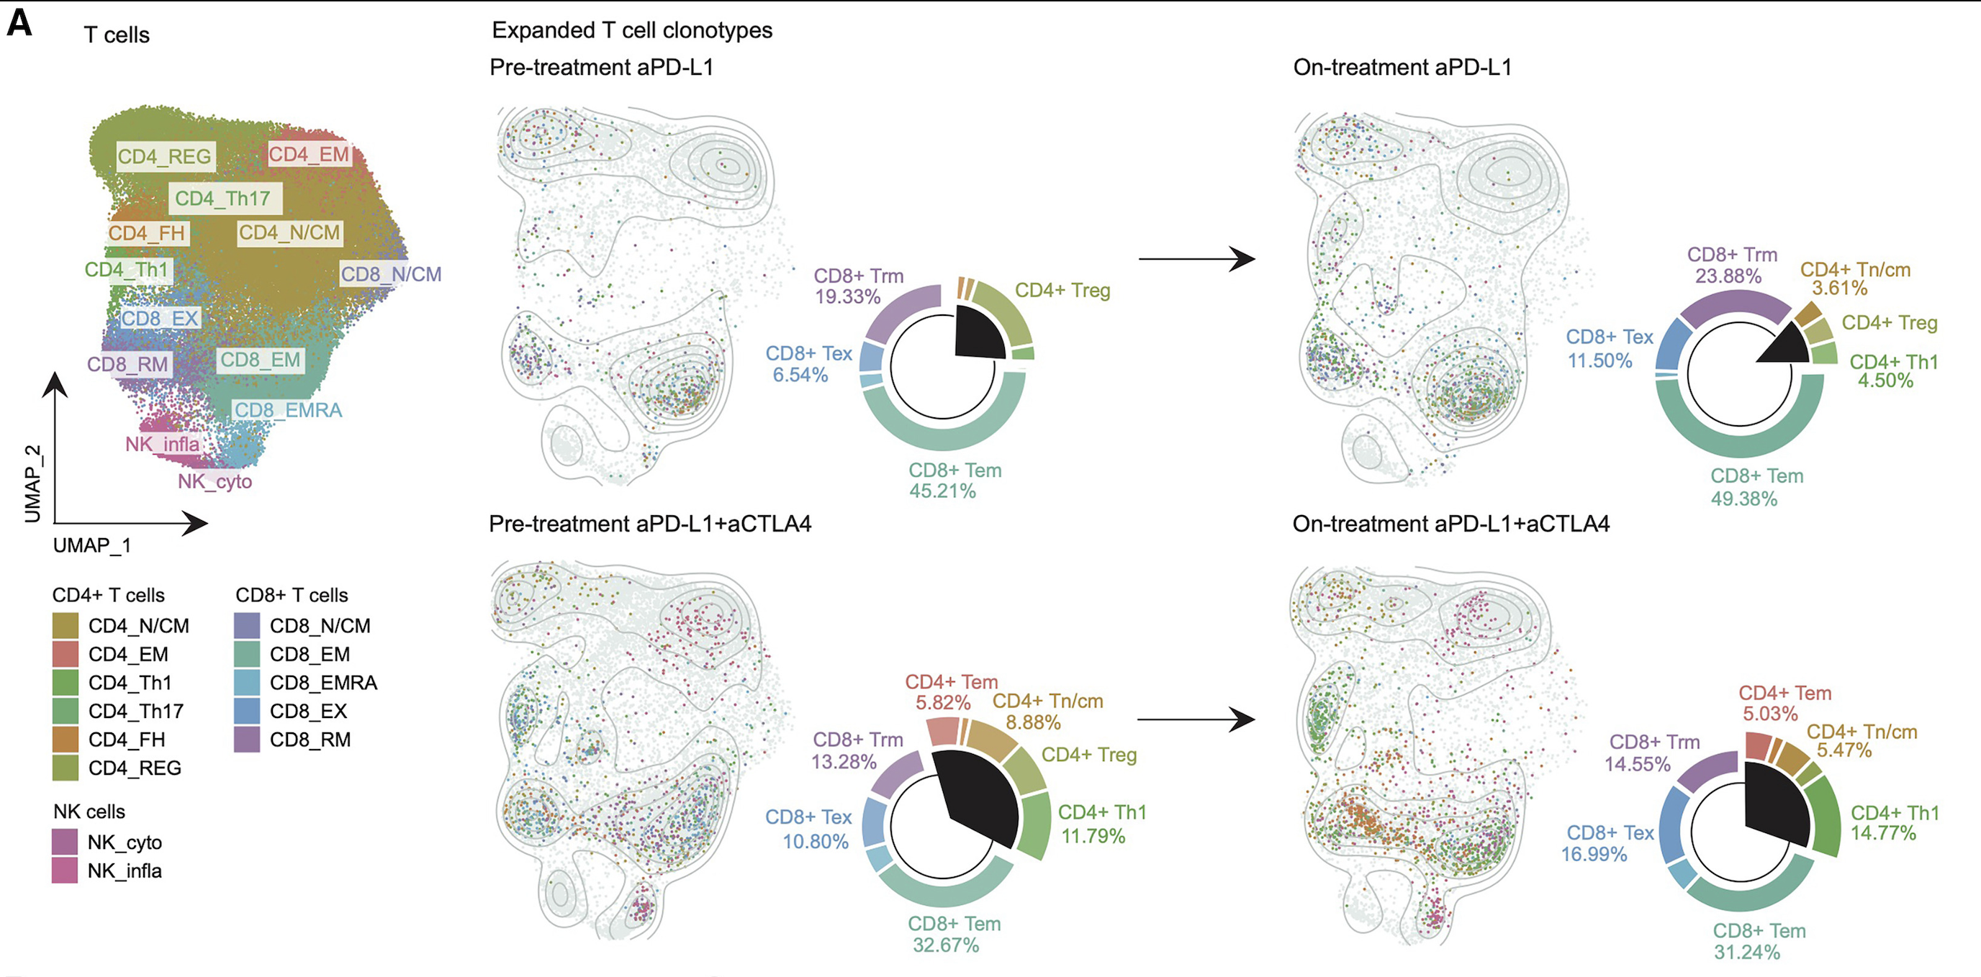
T cells proliferate more after ICB (PMID36787939, PMID36909522, PMID28803728), often associated with ICB response (PMID33597266, PMID32103181, PMID35863822, PMID25428505, PMID37322116, PMID29599411)
Edwards et al. (2018), Clin Cancer Res
Franken et al. (2024), Immunity
Notes:
Look for better figure tbh…

Slide 22
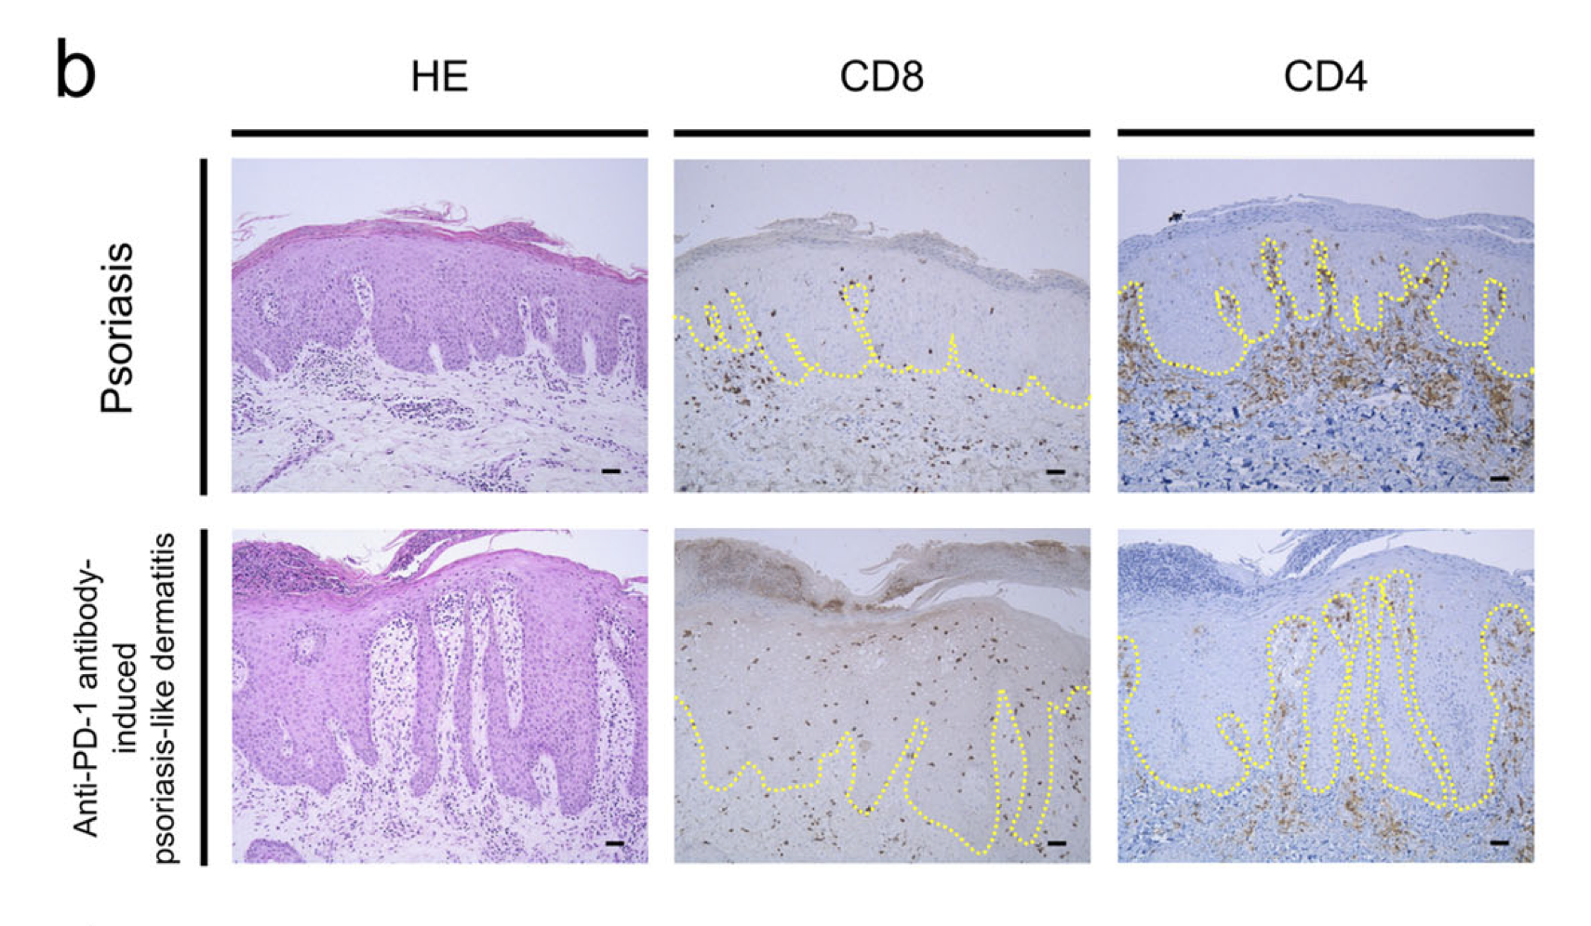
T cells infiltrate irAE tissue (PMID37196065, PMID30832716, PMID27806233, PMID37680638)
Tanaka et al. Commun Biol. 2020

Slide 23
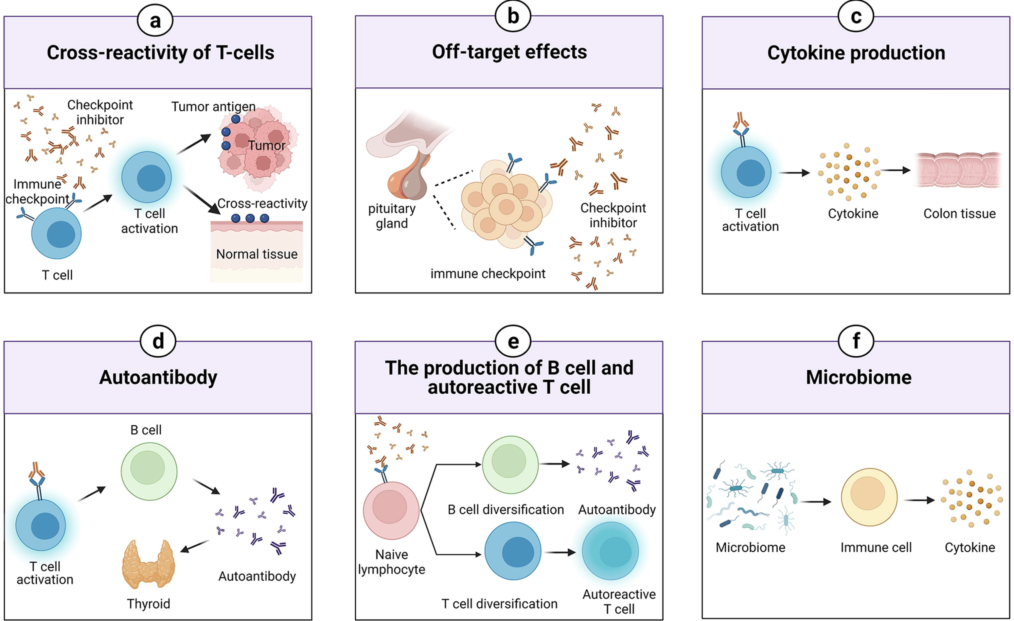
Possible mechanisms driving irAEs
Zheng et al. Materials & Design. 2022
Notes:
TCRs estimated to potentially react with 1 in ~10k encountered peptides (PMID37409132)
Killed tumor cells may release antigens shared by normal cells (i.e. non-tumorigenic proteins still in tumor cell), healthy cells around tumor may also be killed in crossfire and release antigens that induce response
Speculation for what crossreactive T cells are actually targeting, perhaps T cells targeting cancer neoantigens cross-react with WT version of protein in healthy tissue (Autoreactive napsin A-specific T cells are enriched in lung tumors and inflammatory lung lesions during immune checkpoint blockade)
Gouttefangeas et al. Front Immunol. 2023
TCR conceivably could recognize ~ 1 million peptides, crossreactive peptides likely often better agonists than original one that activated T cell, but few (~1%) of peptides are actually presented on MHC, so probably crossreactivity estimate closer to 1 in ~10,000
estimate TCRs to be able to bind ~10^5 to 10^6 peptides (Amino acid similarity accounts for T cell crossreactivity and for "holes" in the T cell repertoire)
What makes TCRs crossreactive? cross-reactivity need not result from sequence similarity (3D structural similarity more important than 1D sequence similarity (Peter’s paper: Autoreactive T cell receptors with shared germline-like α chains in type 1 diabetes)
(b) ICIs can target normal tissues such as hypothalamic and pituitary tissues directly which express immune checkpoint ligand
Pituitary expression of CTLA-4 mediates hypophysitis secondary to administration of CTLA-4 blocking antibody
(c) Activated T cells can release inflammatory mediators which lead to damage in normal tissues
(d) The production of autoantibodies is associated with the risk of irAEs. autoantibodies present ~50% of time for irAEs
(e) ICIs can induce the diversification of lymphocytes as well as promoting T/B cell activation and proliferation
(f) The microbiome with certain bacterial species can shift immune lineage to pro-inflammatory or anti-inflammatory subtypes respectively thereby inducing or resisting irAEs
# Advances in research on molecular markers in immune checkpoint inhibitor-associated myocarditis
- irAE hypotheses: ICIs bind to cell surface proteins (like CTLA-4) in normal tissue leading to T cell infiltration (**this is an obvious one I don't think about much**), crossreactive T cells (T cells recognizing tumor antigens enter circulation and identify similar antigens in healthy tissue), via cytokines (promote infiltration of inflammatory molecules into nontarget tissue, ICIs increase circulating cytokine levels, **this is a good one I don't think about much**), autoantibodies
# B cells as biomarkers: predicting immune checkpoint therapy adverse events
- association between early therapy-induced changes in circulating B cells (decreased B cells, increased plasmablasts and CD21<sup>low</sup>PD-1<sup>+</sup> memory B cells) and an increased risk of high-grade irAEs in patients treated with ICB

Slide 24
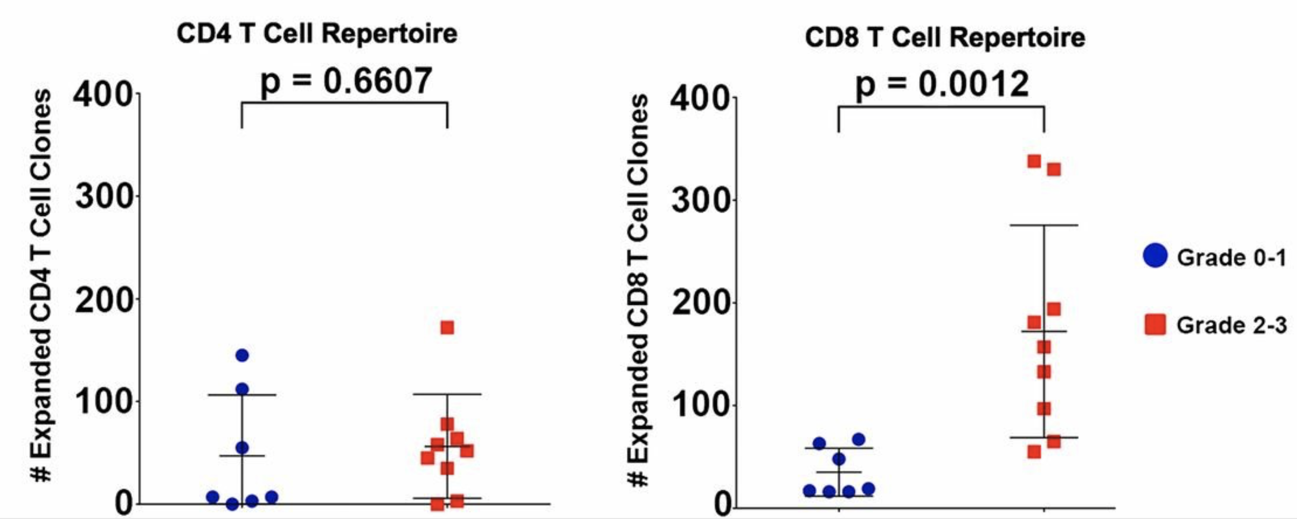
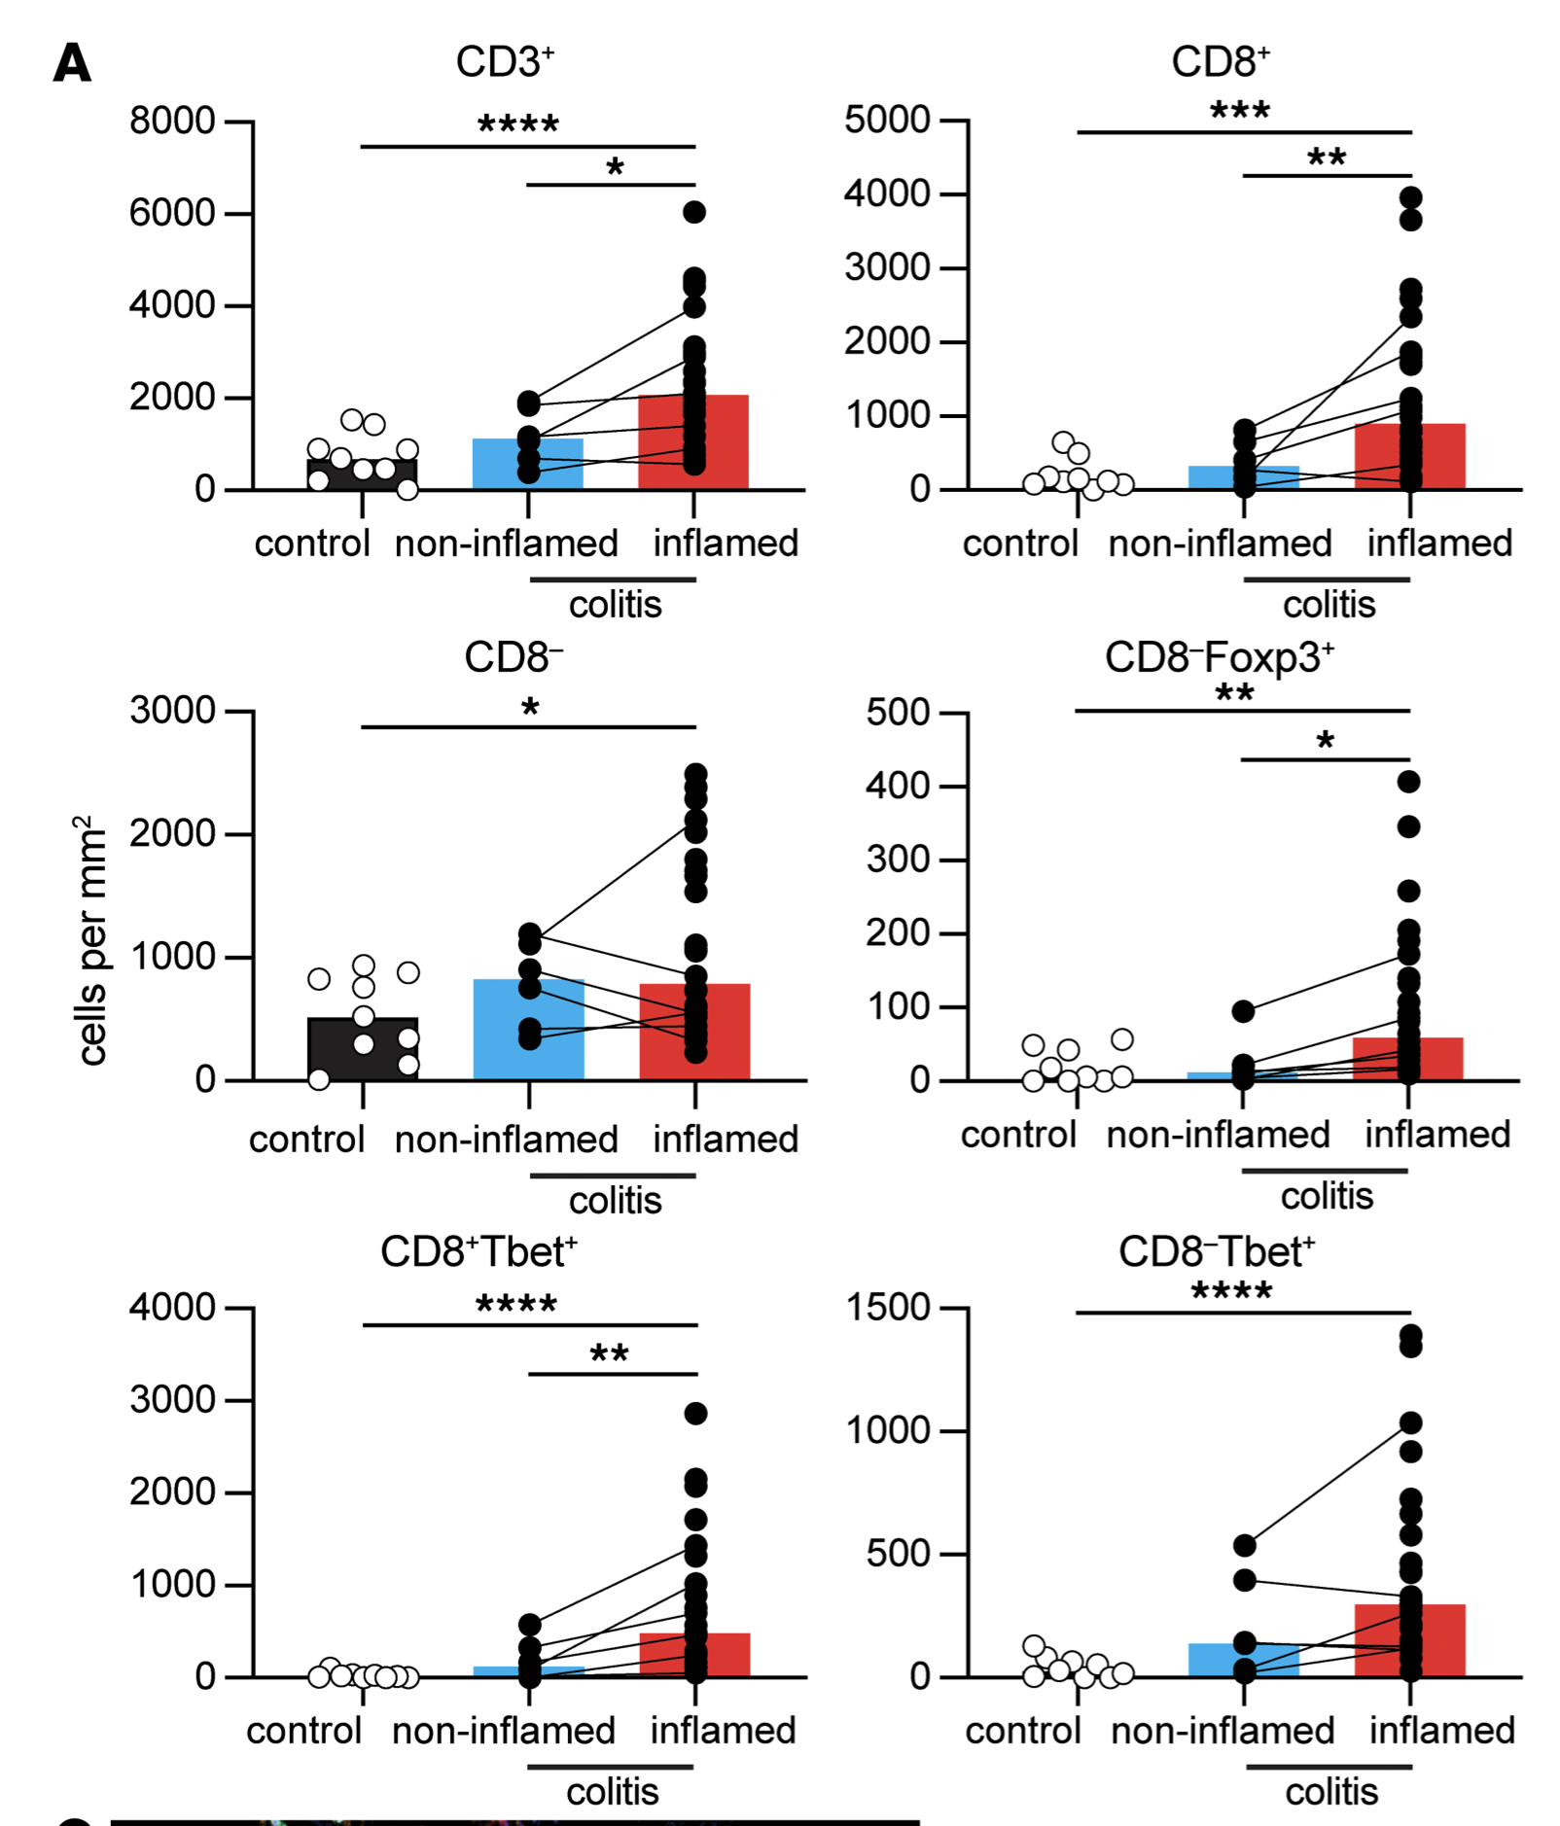
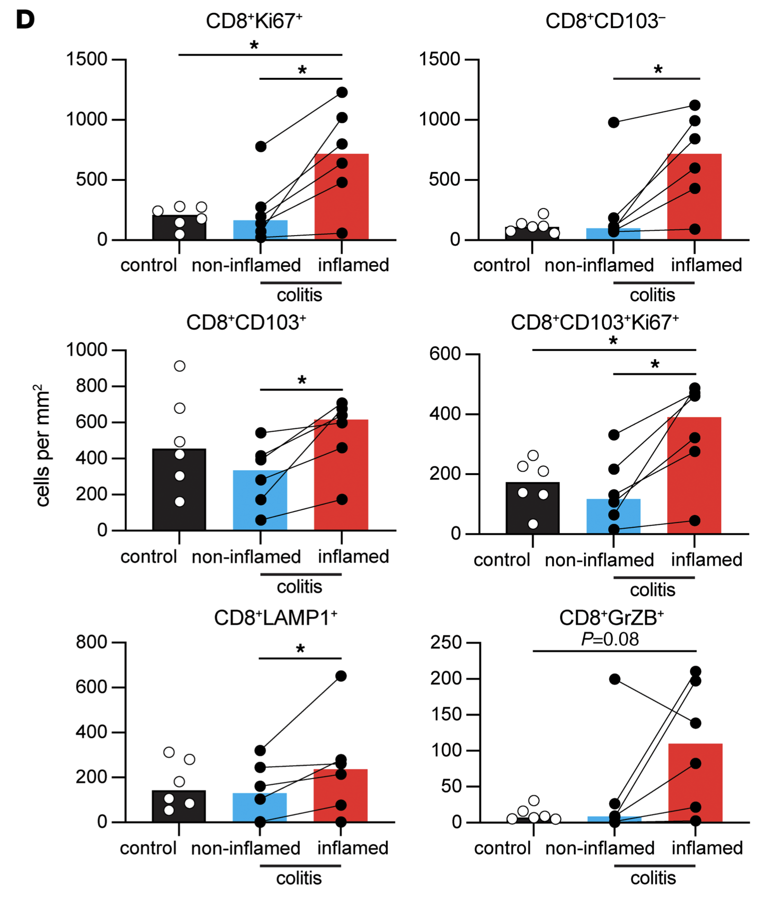
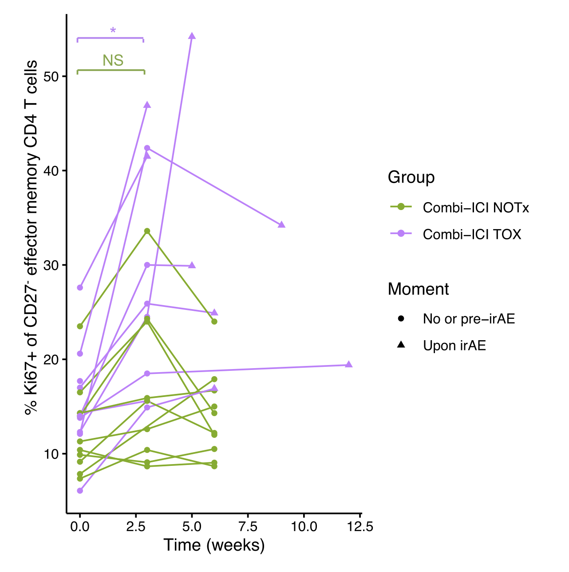
irAEs associated with T cell proliferation following ICB (PMID27698113, PMID35762356, PMID36693381)
Andrews et al. (2021), Nat Med
Nahar et al. (2022), JCI Insight
Subudhi et al. (2016), PNAS
van Eijs et al. (2023), Cancer Immunol Immunother
Notes:
PMID28031229 shows opposite (increased rather than decreased TCR diversity associated with irAEs)

Slide 25
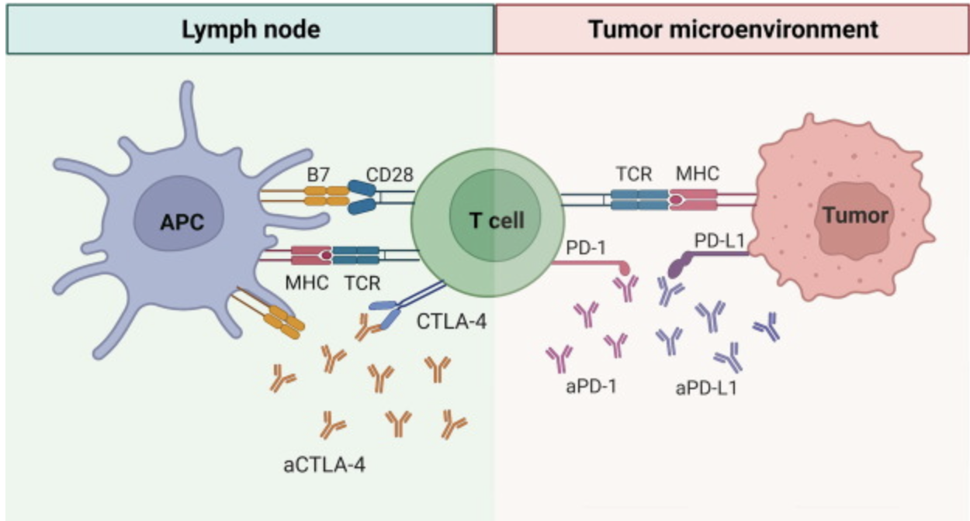
PD-1 and CTLA-4 blockade induce distinct responses despite both converging on Akt signaling
PD-1 blockade more CD8 (immune “normalizer”), CTLA-4 more CD4 (immune “enhancer”)
PD-1 blockade associated with fewer irAEs
PD-1 blockade induces more clonal TCR repertoire, CTLA-4 blockade induces more diversified TCR repertoire
Notes:
Picture: Advanced materials for management of immune-related adverse events induced by immune checkpoint inhibitors
Distinct cellular mechanisms underlie anti-CTLA-4 and anti-PD-1 checkpoint blockade
- PD-1 blockade predominantly induces expansion of specific tumor infiltrating exhausted-like CD8<sup>+</sup> T cell subsets
- CTLA-4 blockade induces expansion of ICOS<sup>+</sup> Th1-like CD4<sup>+</sup> effector T cells, also engages specific subsets of exhausted-like CD8<sup>+</sup> T cells
Immune-related adverse events in checkpoint blockade: observations from human tissue and therapeutic considerations
PD-1 blockade more CD8 effect, CD4 effect more for CTLA-4 blockade
Mechanisms of immune-related adverse events during the treatment of cancer with immune checkpoint inhibitors
anti-CTLA-4 and anti-PD-1/PD-L1 antibodies called "immune enhancers" and "immune normalizers" (normalizing T cell immunity in tumor microenvironment), respectively, consistent with PD-1 blockade having less irAEs
CTLA-4 and PD-1 signaling converge on Akt, regulator of T cell activation
CTLA-4 blockade induces more diversified T cells (including autoreactive ones), PD-1 blockade induce more clonal TCR repertoire and proliferation of intratumoral CD8<sup>+</sup> T cells

Slide 26
irAEs vs. autoimmune conditions
irAEs progress more rapidly, more transient, often display quicker recovery than autoimmune conditions
Notes:
Immune-related adverse events in various organs caused by checkpoint inhibitors
irAEs progress more rapidly than autoimmune conditions, also transient often with quick recovery
severe irAEs may represent a subclinical or latent autoimmune state that is unmasked upon ICI treatment
Perhaps worth trying to make analogy between viral infections preceeding autoimmunity and tumor response preceeding irAEs?
Immune-related adverse events in various organs caused by checkpoint inhibitors
irAEs progress more rapidly than autoimmune conditions, also transient often with quick recovery
CTLA-4 and PD-1 signaling converge on Akt, regulator of T cell activation
CTLA-4 blockade induces more diversified T cells (including autoreactive ones), PD-1 blockade induce more clonal TCR repertoire and proliferation of intratumoral CD8<sup>+</sup> T cells
severe irAEs may represent a subclinical or latent autoimmune state that is unmasked upon ICI treatment

